Slide 1
Usage based Tag enhancement of Images
Project taken at
Big data experience lab
Adobe systems
by
Saurabh Verma
IIT Roorkee

Slide 2
Acknowledgements
I would like to take this opportunity to sincerely thank my team members, Balaji Vasan(BEL Adobe), Noman Sheikh(IIT Delhi) and Roshan Kumar(IIT Kanpur) for their collaboration in the project.
I am also thankful to Lab Members for their invaluable ideas and suggestions.
I am highly indebted to Prof. Niloy Ganguly(IIT Kharagpur) for making the project reach these heights.

Slide 3
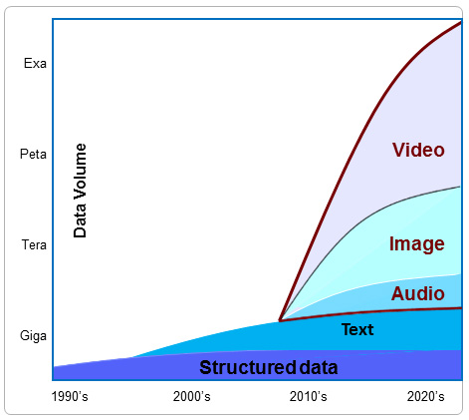
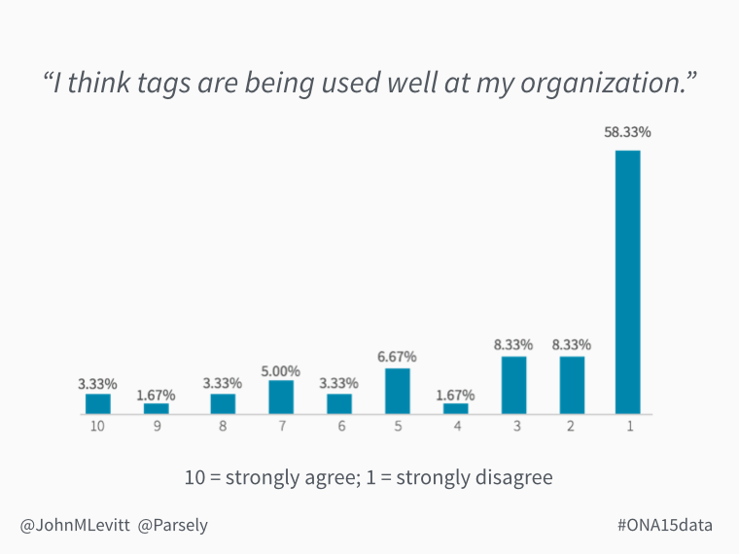
What is tagging? Why do we need it?
https://avindh2014.wordpress.com/background/
http://blog.parsely.com/post/2565/ona15data-a-year-in-data-from-parse-ly/parse-ly/

Slide 4
What if there was a system that could bridge the gap between what images contain and how they are perceived?
What if there was a system that can give a set of tags that maximizes their significance in retrieval?

Slide 5
Problem statement: Given an image and set of associated content, enhance the set of tags based on it's usage
Develop a semantic understanding of the image content
Enhance a given set of tags using background knowledge
Improve retrieval and recommendation by using the given tags

Slide 6
Running Example
http://www.npr.org/sections/parallels/2016/03/22/471401729/in-vulnerable-europe-a-third-major-terrorist-attack-in-a-year

Slide 7
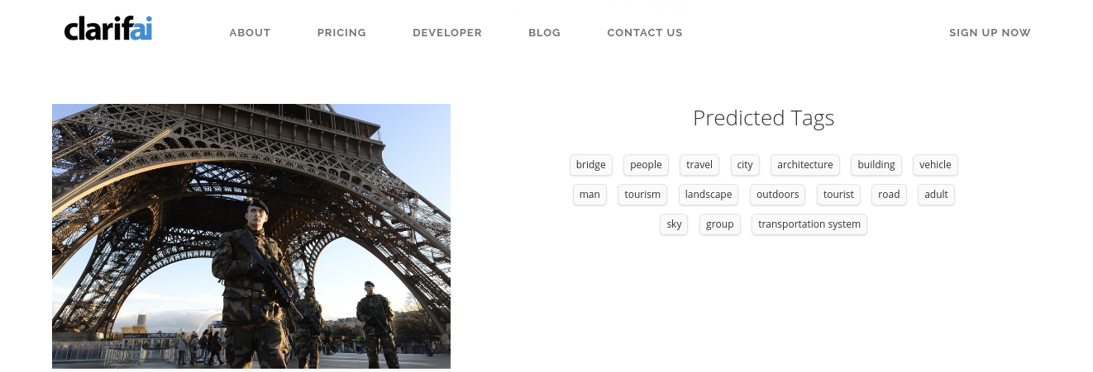
Tags from Clarifai API
https://www.clarifai.com/#demo

Slide 8
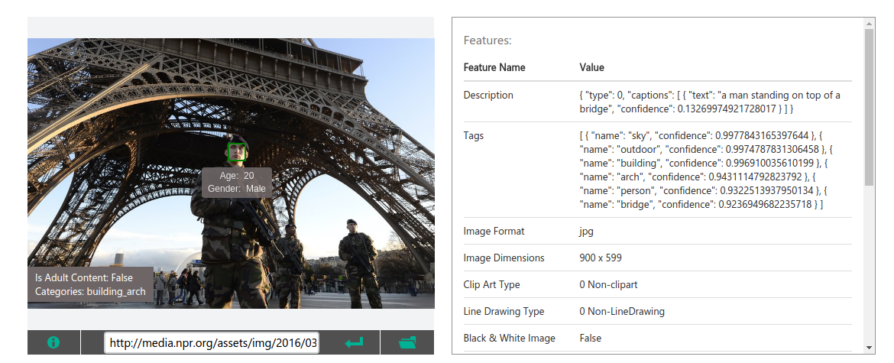
Tags from Microsoft Vision API
https://www.microsoft.com/cognitive-services/en-us/computer-vision-api

Slide 9
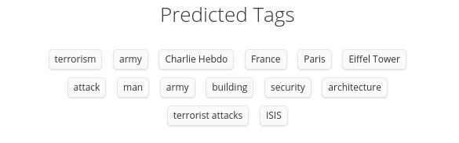
Tags derived by our pipeline

Slide 10
Prior Art (Academic)
Text mining for automatic image tagging
Leong et al., Proceedings of the 23rd International Conference on Computational Linguistics: Posters. Association for Computational Linguistics, 2010.
Zhang, Dengsheng, Md Monirul Islam, and Guojun Lu. Pattern Recognition 45.1 (2012): 346-362.
A review on automatic image annotation techniques

Slide 11





Prior Art (Industry)
https://cloud.google.com/vision/
https://www.microsoft.com/cognitive-services/en-us/computer-vision-api
https://www.ibm.com/watson/developercloud/visual-recognition.html
https://imagga.com/solutions/auto-tagging.html
https://www.clarifai.com/api

Slide 12
Workplan
Week 1-2 : Brainstorm
Week 3: Problem Alternative
Week 4: Solution Framework
Week 12: Documentation
Week 5-8: Coding & Testing
Week 9-10: Evaluation & Tuning
Week 11: Final Presentation

Slide 13
Objectives
Combine visual and textual features for tagging of images
Enhance the given set of tags using background knowledge from large knowledge bases
Use the final tags to improve retrieval and recommendation engines
Develop a cross-platform and re-entrant pipeline

Slide 14
Solution Framework
Tag Shortlisting
Tag Extraction
Inter-tag relationship
Tag Importance

Slide 15
Tag Shortlisting
Input Image
Clarifai API
Candidate Tags with weights
Input associated Text
AIDA - YAGO
Stanford NLP Parser
Named Entities and Noun Phrases

Slide 16
Tag Importance
Frequency
Total frequency of the candidate tag occurrence in the associated text accounting for the co-reference or indirect mentions
Distance in dependency tree
Inverse of the average distance of the entity from the root of the corresponding dependency tree obtained through a dependency parser.
Final Score
The average of the two measures above.

Slide 17
Inter-tag relationship
Word2Vec
Co-occurrence
Pre-trained model trained on a corpus of Google News dataset with 100 billion words resulting in a final corpus of 3 million word representations.
Yields a 300-dimensional vector for candidate tag representing the word in the space of trained deep neural network.
Cosine-similarity to capture semantic closeness between the tags for interchangeable use.
Point-wise Mutual Information between two entities based on their co-occurrences in the Wikipedia articles.
Similarity based on how coherent the two tags are. It measures topical closeness.
$$pmi\left(x;y\right)=log\frac{p(x,y)}{p\left(x\right)p(y)}$$
𝑝𝑚𝑖(𝑥;𝑦)=𝑙𝑜𝑔 (𝑝(𝑥,𝑦))/(𝑝(𝑥)𝑝(𝑦))

Slide 18
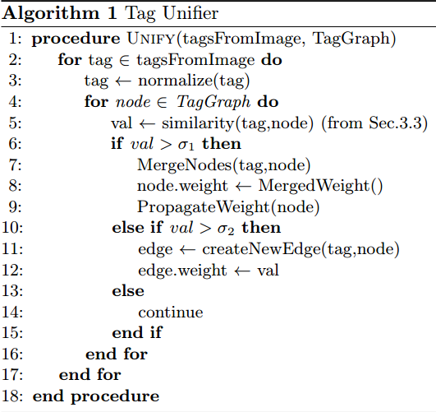
Inter-tag relationship

Slide 19

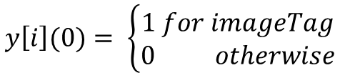
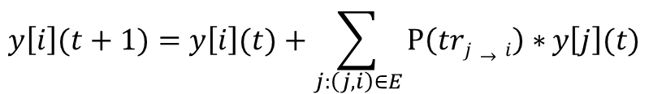

Tag Extraction
Problem : Identify top nodes in the tag graph that are closely connected to the visual tags.
Chitrapura, Krishna P., and Srinivas R. Kashyap. "Node ranking in labeled directed graphs." Proceedings of the thirteenth ACM international conference on Information and knowledge management. ACM, 2004.
$$P\left(i→j\right)=eij∗nj$$
P⁡(𝑖→𝑗)=𝑒_{𝑖𝑗}∗𝑛𝑗
$$P\left(i→i\right)=ni$$
P⁡(𝑖→𝑖)=𝑛_{𝑖}
$$y\left[i\right](t+1)=y\left[i\right](t)+\sum_{j:\left(j,i\right)∈E}{P{(j→i)}∗}y\left[j\right](t)$$
𝑦[𝑖](𝑡+1)=𝑦[𝑖](𝑡)+∑_(𝑗:(𝑗,𝑖)∈𝐸)▒〖P⁡〖(𝑗→𝑖)〗∗〗 𝑦[𝑗](𝑡)
$$y\left[i\right](0)= \left\{\begin{aligned} 1 for imageTag \\ 0 otherwise\end{aligned}\right.$$
𝑦[𝑖](0)= {█( 1 𝑓𝑜𝑟 𝑖𝑚𝑎𝑔𝑒𝑇𝑎𝑔@0 𝑜𝑡ℎ𝑒𝑟𝑤𝑖𝑠𝑒)┤
$$P\left(tri→j\right)=eij∗nj$$
$$P\left(tri→i\right)=ni$$
$$y\left[i\right](t+1)=y\left[i\right](t)+\sum_{j:\left(j,i\right)∈E}{P\left(trj→i\right)∗}y\left[j\right](t)$$
$$y\left[i\right](0)= \left\{\begin{aligned}1 for imageTag \\ 0 otherwise\end{aligned}\right.$$

Slide 20
Evaluation & Results

Slide 21
Dataset
Leong et al. "Text mining for automatic image tagging." Proceedings of the 23rd International Conference on Computational Linguistics: Posters. ACL, 2010.
300 image-text pairs collected by issuing a query to Google Image API and processing one of the query results that has a significant amount of text around the images. Also created a gold standard tag set based on manual annotations from 5 annotators via Amazon Mechanical Turk accepting annotations from annotators with approval rating > 98%. We used the Clarifai API [18] to generate the visual tags for all our experiments.
http://lit.csci.unt.edu/index.php/Downloads

Slide 22
Metrics – Term Significance
The intuition here is to compute how important a tag is to the given context(usage) and normalize it with its “commonness” across a bigger corpus
Lu, Yu-Ta, et al. "A Content-Based Method to Enhance Tag Recommendation." IJCAI. Vol. 9. 2009.
Significance(tags) = NDCG(TF-IDF(tag) for tag in tags)

Slide 23
Metrics – Tag Relevance
To capture the relevance of the tags to the image in hand using gold-standard human annotations.
Philip Resnik. 1995. Using information content to evaluate semantic similarity in a taxonomy. In Proceedings of the 14th international joint conference on Artificial intelligence - Volume 1 (IJCAI'95), Chris S. Mellish (Ed.), Vol. 1. Morgan Kaufmann Publishers Inc., San Francisco, CA, USA, 448-453.
$$sim=\frac{1}{N}\sum_{i}{\frac{\sum_{g_{j}∈TopK(G, Ti)}{sim⁡(g_{j}, T_{i})γ^{j}}}{\sum_{j}{γ^{j}}}}$$
𝑠𝑖𝑚=1/𝑁 ∑_𝑖▒(∑_(𝑔_𝑗∈𝑇𝑜𝑝𝐾(𝐺, 𝑇𝑖))▒〖sim⁡(𝑔_𝑗, 𝑇_𝑖)𝛾^𝑗 〗)/(∑_𝑗▒𝛾^𝑗 )

Slide 24
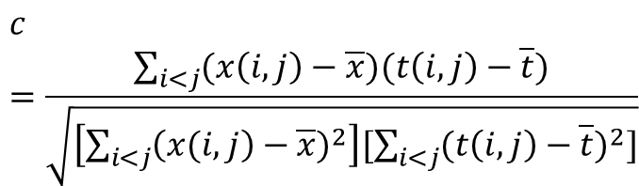
Metrics – Cophenet Correlation Coeffiecient
How faithfully a dendogram preserves the pairwise distances between the original un-modeled data points?
Sokal, et al. "The comparison of dendrograms by objective methods." Taxon (1962): 33-40.
Higher value of the cophenet correlation coefficient indicates presence of more significant clusters and hence, more tag diversity.
$$c=\frac{\sum_{i<j}{(x\left(i, j\right)−\overline{x}\text{)}(t\left(i, j\right)−\overline{t}\text{)}}}{\sqrt{\left[\sum_{i<j}{{\left(x(i, j\right)−\overline{x})}^{2}}\right][−\sum_{i<j}{{(t\left(i, j\right)−\overline{t})}^{2}}]}}$$
𝑐=(∑_(𝑖<𝑗)▒〖(𝑥(𝑖, 𝑗)−¯𝑥 ")" (𝑡(𝑖, 𝑗)−¯𝑡 ")" 〗)/√([∑_(𝑖<𝑗)▒〖(𝑥(𝑖, 𝑗)−¯𝑥)〗^2 ][−∑_(𝑖<𝑗)▒〖(𝑡(𝑖, 𝑗)−¯𝑡)〗^2 ])
$$c=\frac{\sum_{i<j}{(x\left(i, j\right)−\overline{x}\text{)}(t\left(i, j\right)−\overline{t}\text{)}}}{\sqrt{\left[\sum_{i<j}{{\left(x(i, j\right)−\overline{x})}^{2}}\right][\sum_{i<j}{{(t\left(i, j\right)−\overline{t})}^{2}}]}}$$

Slide 25
Baselines
Imagga
Microsoft Vision
Text mining for automatic image tagging
Gold-standard Human Annotations and Visual autotagging engine
http://lit.csci.unt.edu/index.php/Downloads
https://imagga.com/auto-tagging-demo
https://www.microsoft.com/cognitive-services/en-us/computer-vision-api
Leong et al. "Text mining for automatic image tagging." Proceedings of the 23rd International Conference on Computational Linguistics: Posters. ACL, 2010.

Slide 26
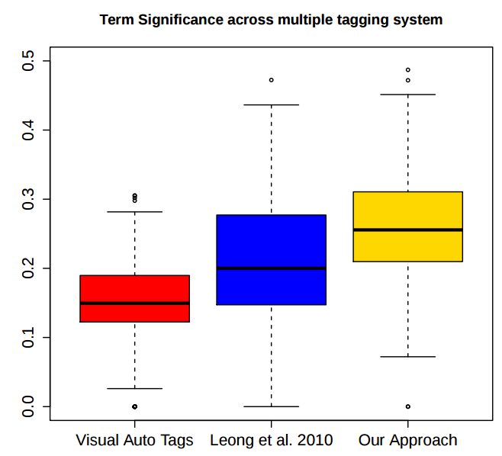
Tagging Performance
Term Significance

Slide 27
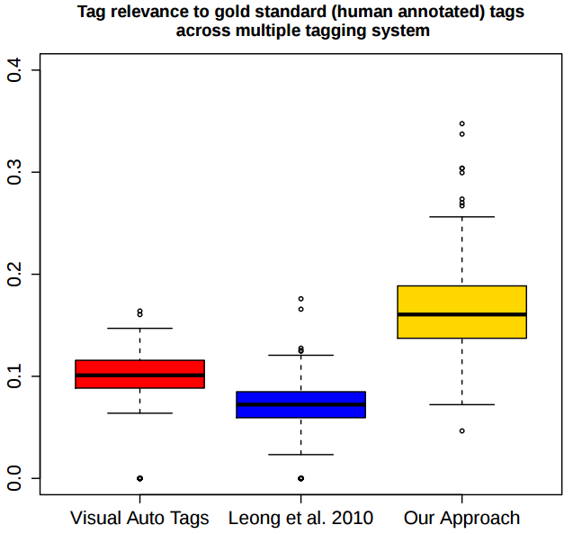
Tagging Performance
Tag Relevance

Slide 28
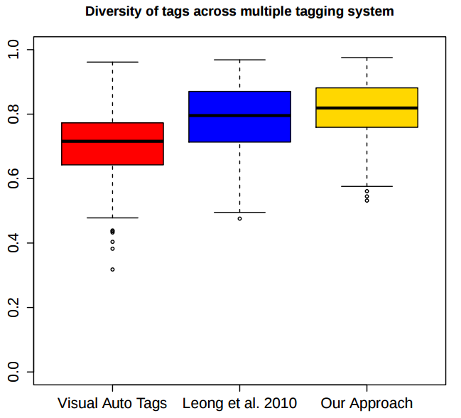
Tagging Performance
Diversity

Slide 29
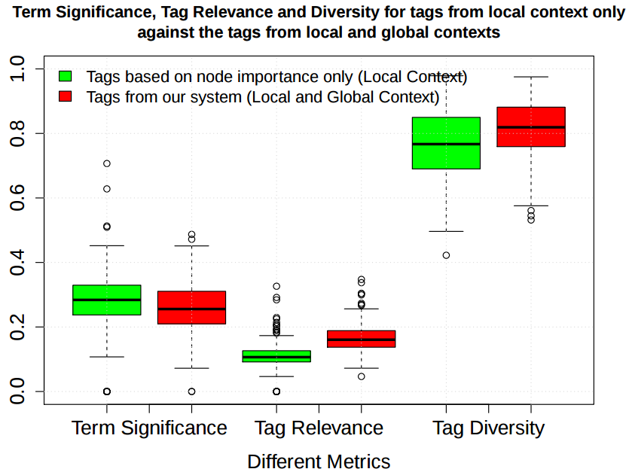

Slide 30
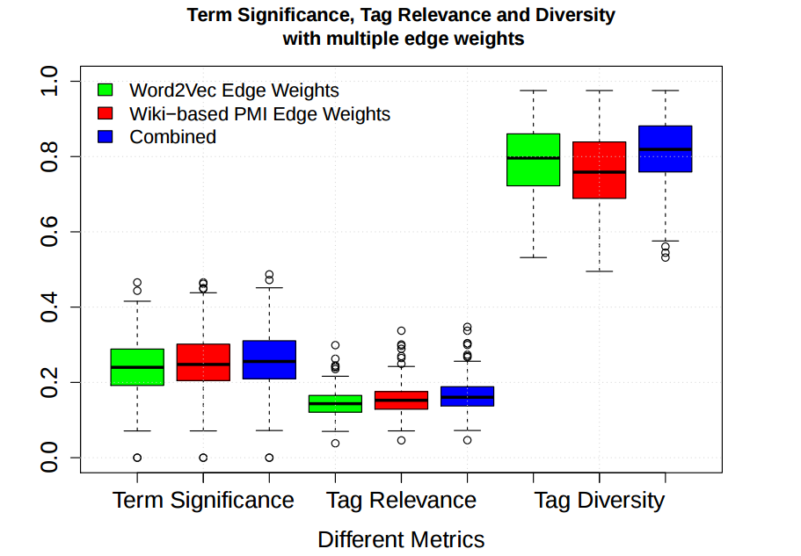

Slide 31
Future Work
Extend this work for multimedia content using the same principal pipeline
Capture multiple word senses in associated content.
Optimize the application for low latency solution
Offer solution for rarely used images

Slide 32
Publication
In the Proceedings of Pacific-Asia Conference on Knowledge Discovery and Data Mining (PAKDD2017) Conference as a long presentation paper with the title "Usage based Tag enhancement of images".
Out of 458 submissions, 45 papers are selected as long presentation paper.

Slide 33
Thank you

